Slide 1
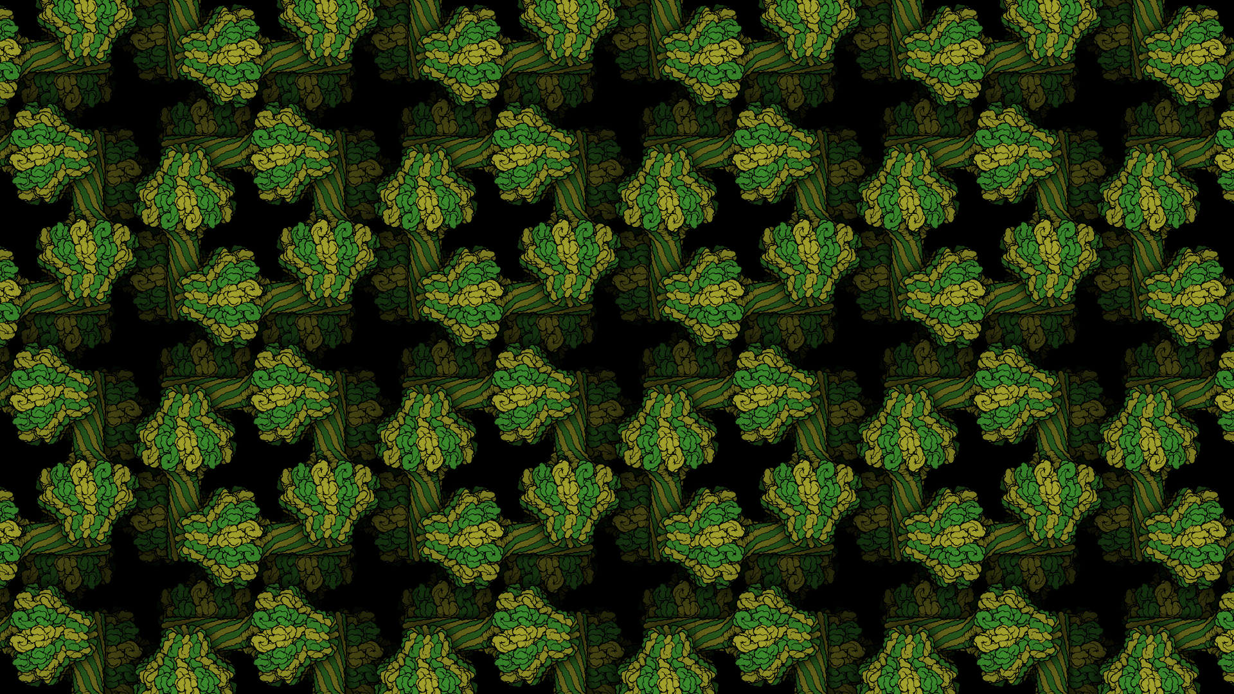
Molecular Modeling Program: Pymol (3)
Evan Edelstein
Notes:
https://pdb101.rcsb.org/learn/other-resources/molecular-backgrounds-for-virtual-meetings

Slide 2
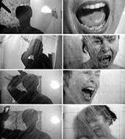
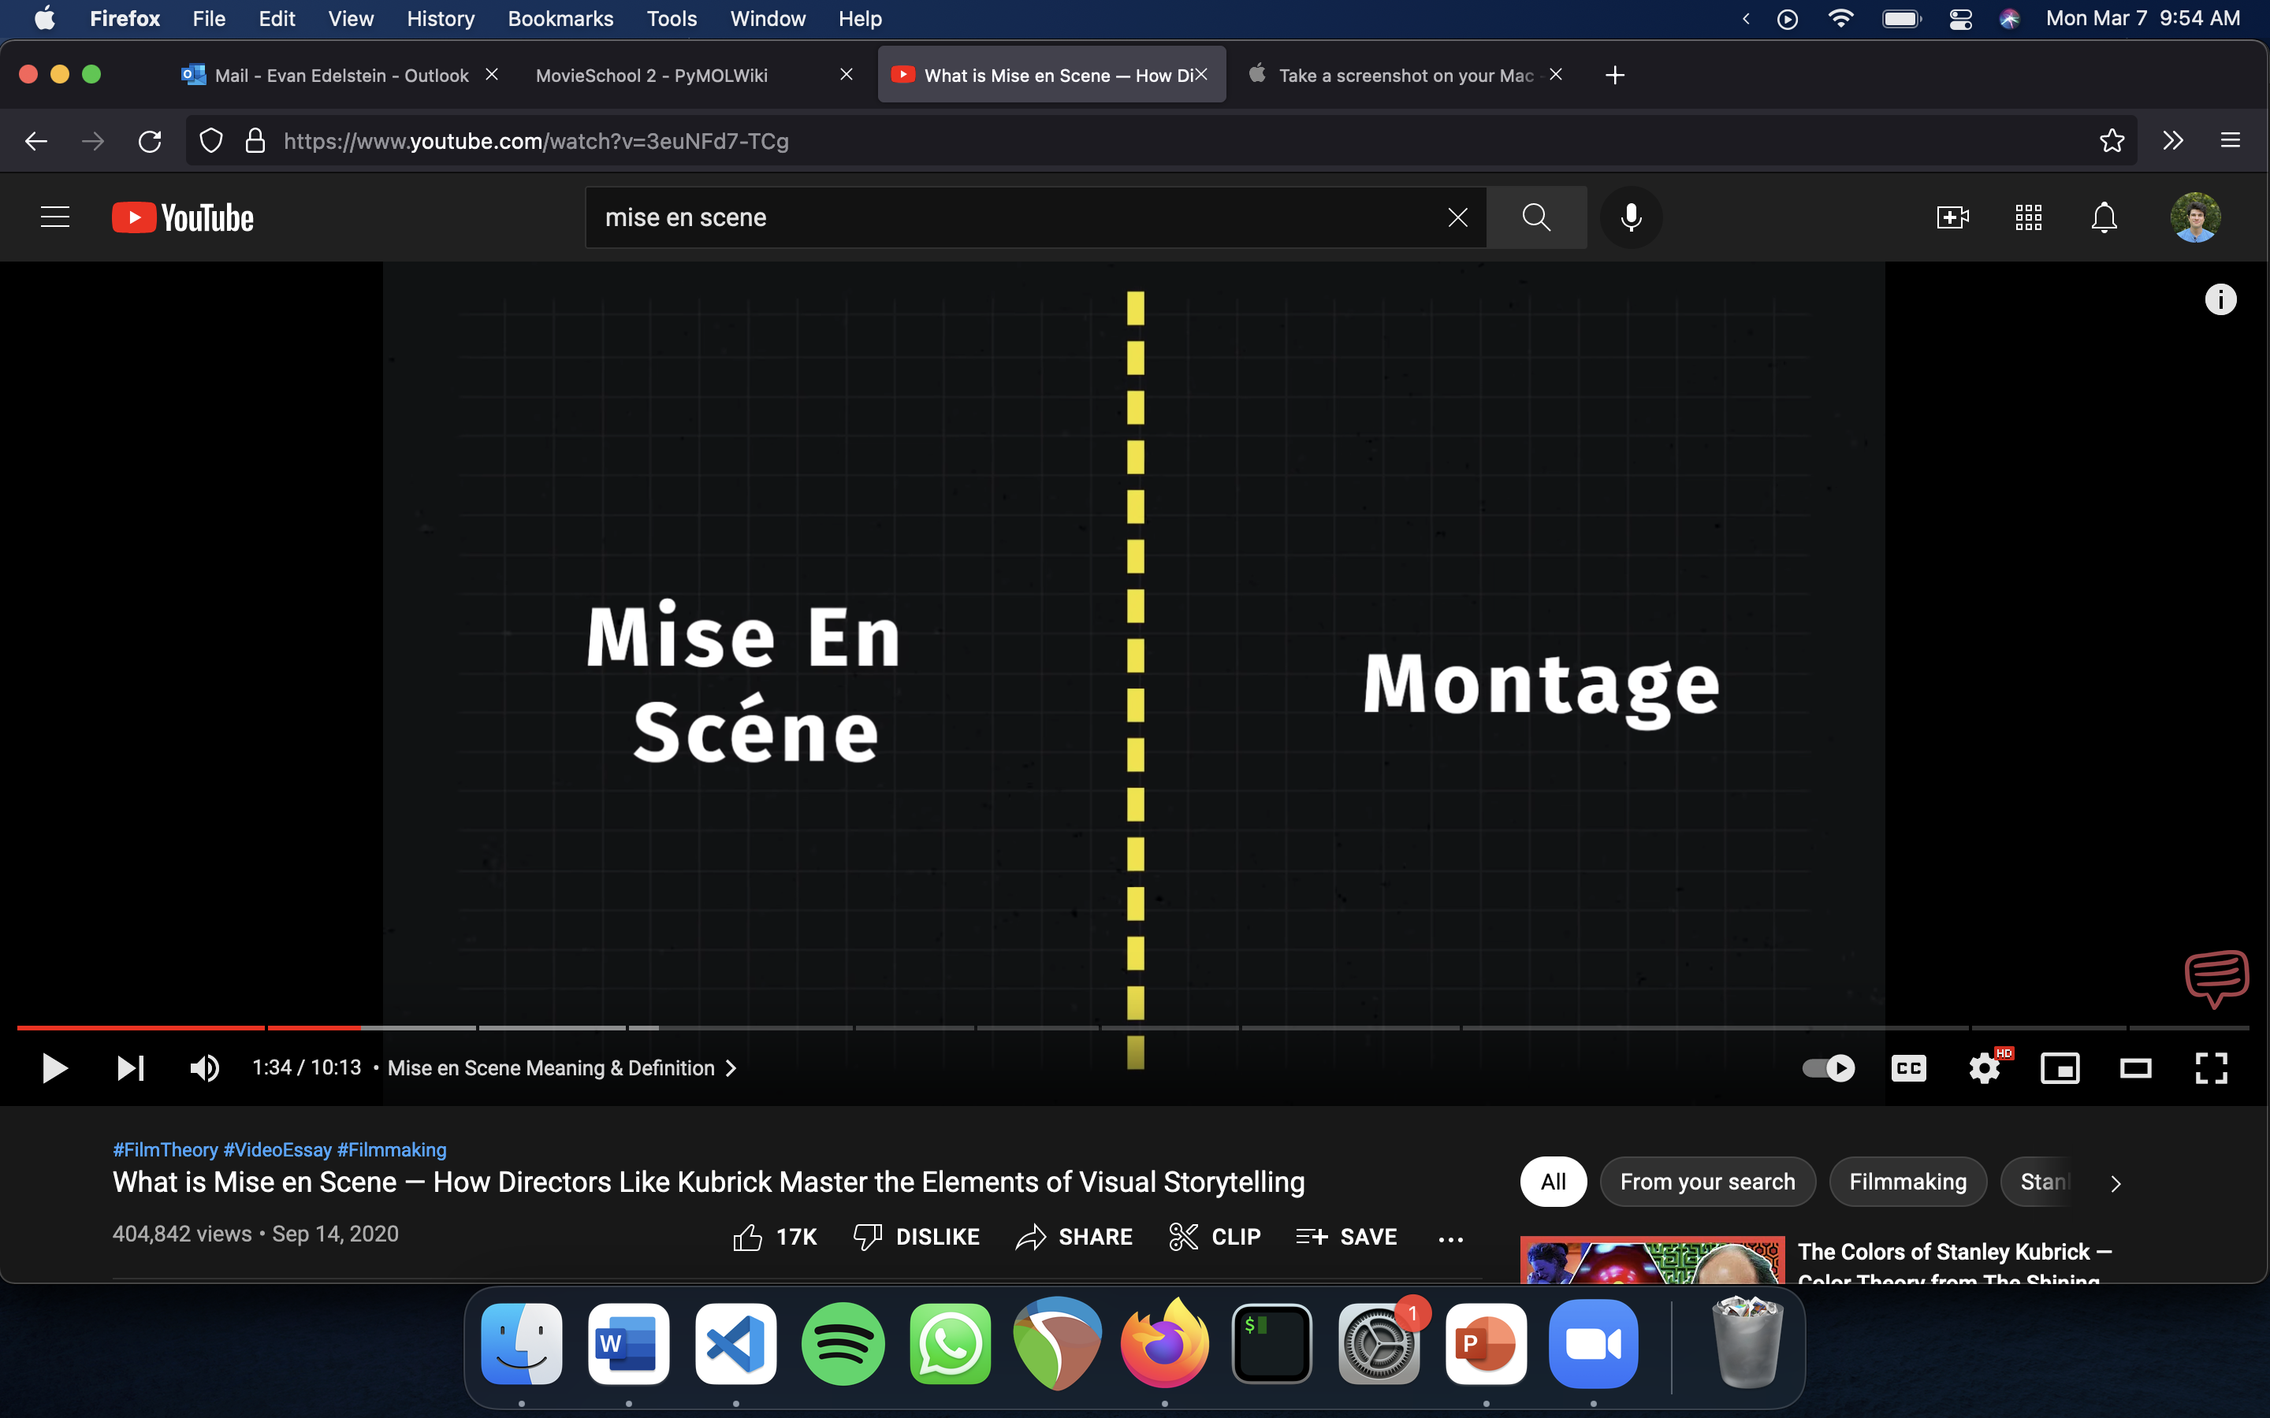
Intro to Cinematography:
The essence of Mise-En-Scene is what to include in the scene.
And Montage is the meaning creating from the juxtaposition of scenes.

Slide 3
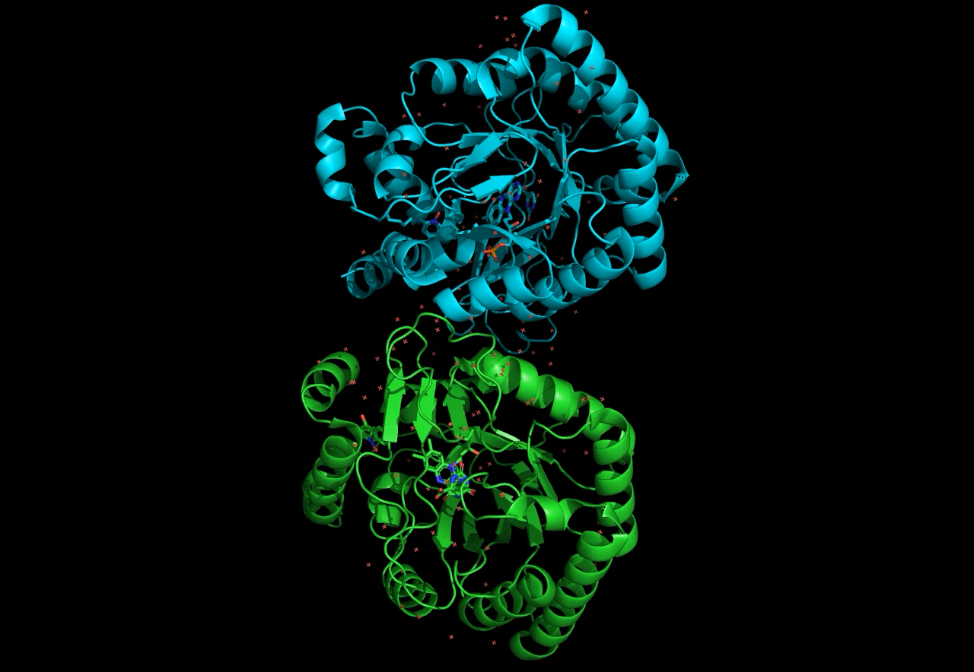
Animation in Pymol: Preset Motion
Easy presets using the movie command:
movie.add_roll(duration, loop, axis, start)
movie.add_rock(duration, angle, loop, axis, start)
movie.produce(‘name.mp4’, mode = ‘ray’)
(these are python commands so use quotes around strings)
Notes:
7T5K

Slide 4
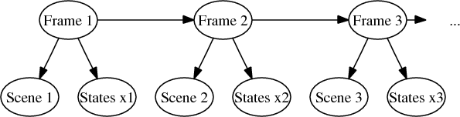
Animation in Pymol: Components
There are three main Components of animation in Pymol:
Scenes: Camera/Object Information (orientation, color, representation).
States: Biological Information/Coordinates (movement, translation, mutation).
Frames: a collection of Scenes and States.

Slide 5
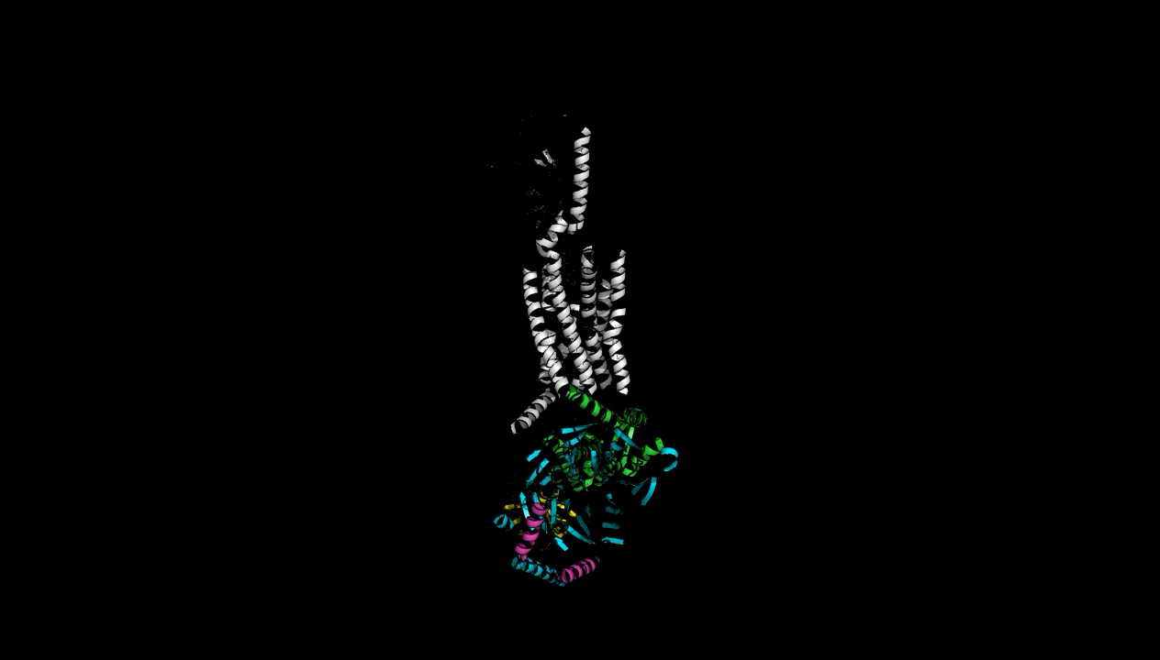
Animation in Pymol: Scenes (1)
Simple animation can be made by adjusting the view, i.e. predefined camara movement around a static image.
mset 1x60 : for 60 frames or 2 second movie
mview store: store first scene
Change camera angle. ex zoom, orient etc.
mview store, 30
mview reinterpolate
mplay
The appearance affect if from manipulation the depth not from adjustment of the state
Notes:
Fetch 7BIA
select trip, chain P
mset 1x60
Mview store
zoom trip
util.cnc
mview store, 15
mview reinterpolate
set ray_trace_mode, 1
set antialias, 2
set ray_shadows, on
set ray_trace_color, black
set ray_trace_gain, 0
set ray_trace_fog=0

Slide 6
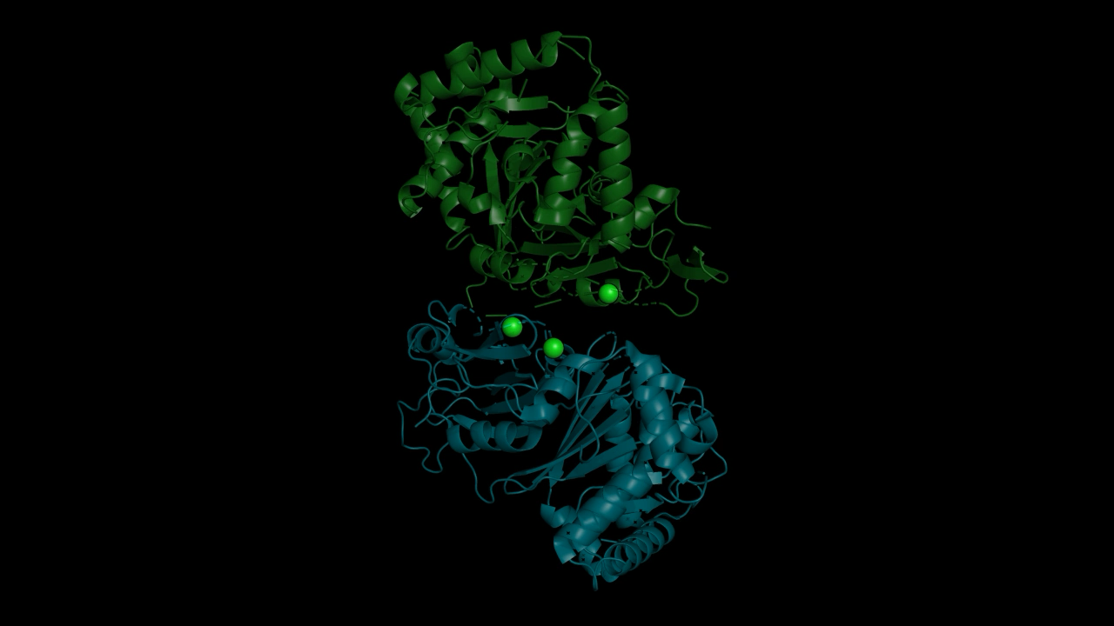
Animation in Pymol: Scenes (2)
More advanced scenes can be composed using the Scene command. This allows us to store all the information on screen.
`mset 1x60`
`scene 1, store`
`mview store, 1, scene=1`
Change represention, color, or camera view
`scene 2, store`
`mview store, 30, scene=2`
…
Notes:
fetch 6CHJ
util.cbc
util.cnc
mset 1x60
scene 1, store
mview store, 1, scene=1
preset.interface()
extract interface, rep sticks
set cartoon_transparency, 0.6
zoom interface
scene 2, store
mview store, 15, scene=2

Slide 7
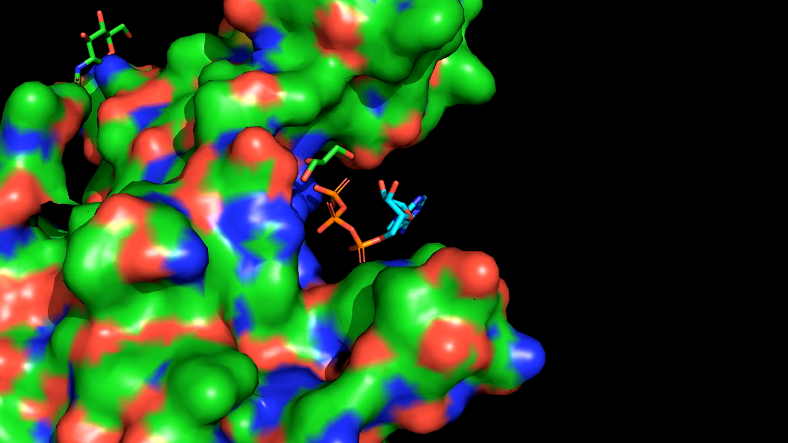
Animation in Pymol: States
More advanced animation can be made by creating new states. States can be made from static pdb structures using the morph command or from multistate pdbs such as those generated by NMR or MD.
fetch 4DW0 (unbound)
fetch 4DW1 (bound)
align 4DW0, 4DW1
morph morph01, 4DW0, 4DW1
extract ligand, 4DW1 and organic
Notes:
https://pymol.org/tutorials/moviemaking/

Slide 8
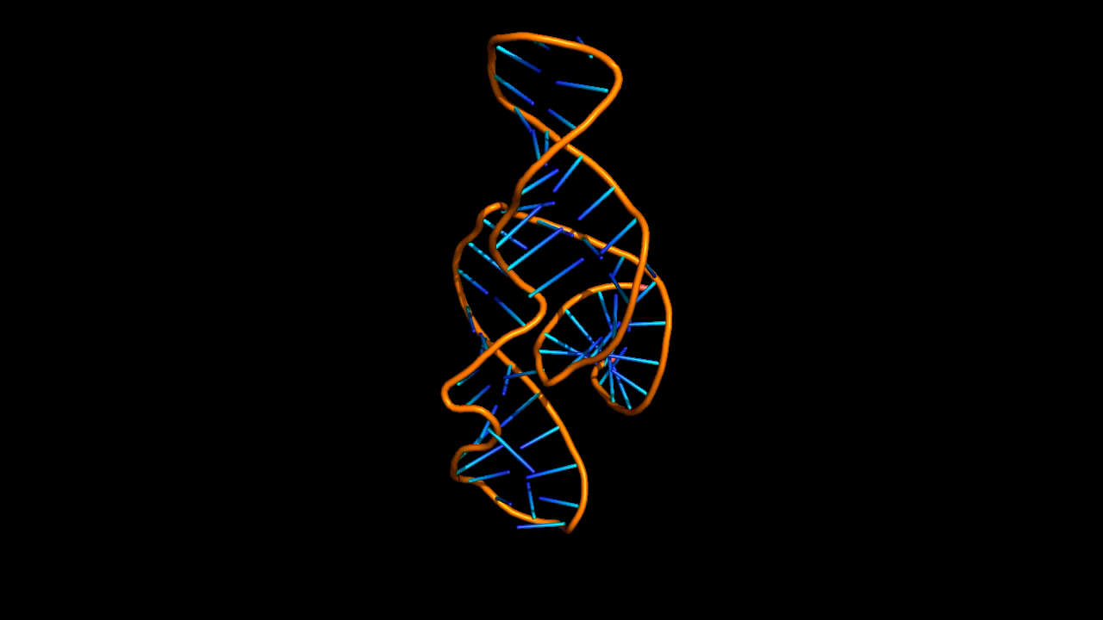
Animation in Pymol: NMR
The conformations in a NMR structures can act as states and be looped over.
Notes:
fetch 2N3Q

Slide 9
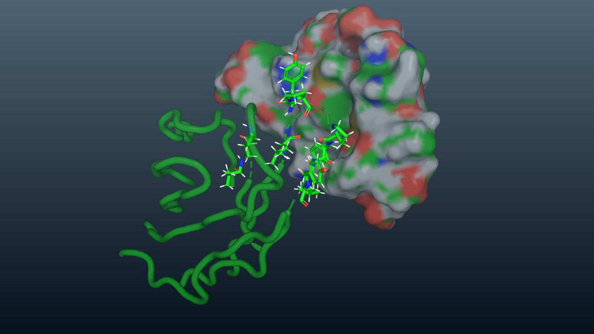
Animation in Pymol: MD Simulation
For Amber21 change the file extensions .prmtop to .top and .mdcrd to .trj.
set defer_builds_mode, 3
load `topology file`
load_traj `trajectory file`
smooth
intra_fit SampleTrajectory
The frames of the MD are now saved as states and can converted into a movie.

Slide 10
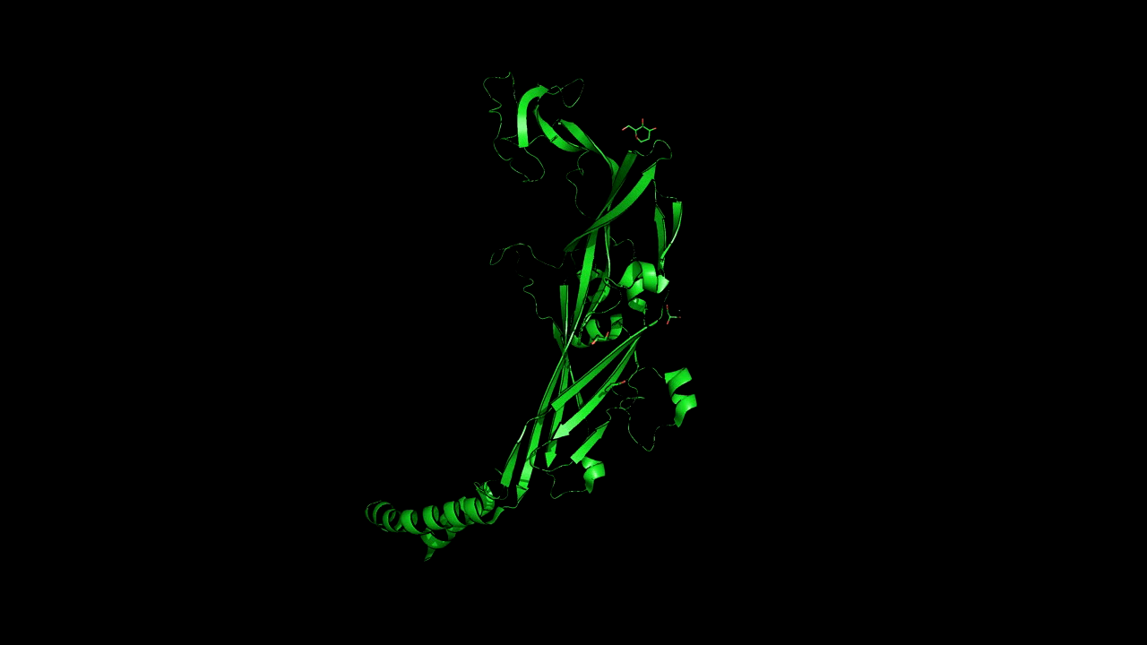
Animation in Pymol: Scenes and States
Load a multistate object and use the following command to map each frame/scene to a state.
cmd.mset("1 -%d" % cmd.count_states())

